Slide 1
ShanghaiTech University
EE 115B: Digital Circuits
Fall 2024
Lecture 14
Hengzhao Yang
November 28, 2024

Slide 2
Gated SR latch
Gated SR latch
  Add a signal to control the time when the set and reset signals change values
Two implementations
  NOR gates
  NAND gates

Slide 3
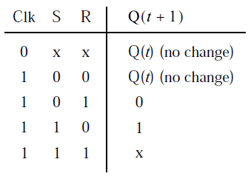
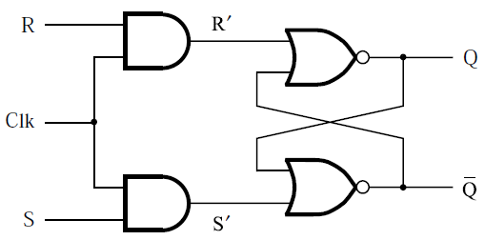
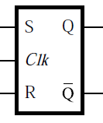
Gated SR latch with NOR gates
Control signal: Clk
  Clk=0, disabled: latched
  Clk=1, enabled: basic SR latch
  Left to right: circuit, circuit symbol, and characteristic table

Slide 4
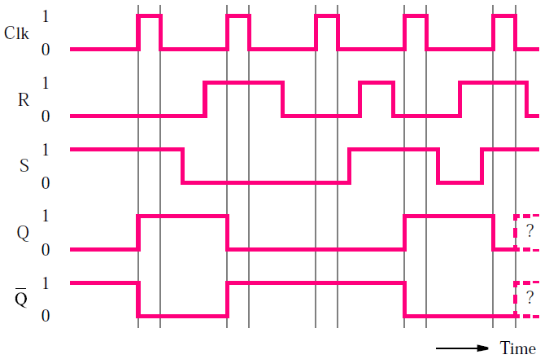
Gated SR latch with NOR gates
Timing diagram

Slide 5
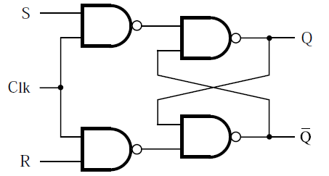
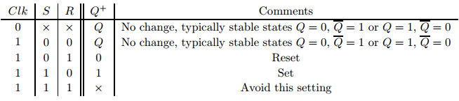
Gated SR latch with NAND gates
Circuit
Same circuit symbol and characteristic table
Source: http://ecse.bd.psu.edu/cse271/memelem.pdf

Slide 6
Summary: gated SR latch
Two implementations
  NOR gates
  NAND gates
    Preferred (requires fewer transistors)

Slide 7
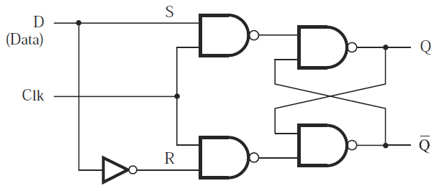
Gated D latch
Only one input: D (data)
Functionality
  Clk=1: output (Q) follows input (D)
  Clk=0: Q holds its previous value
Circuit

Slide 8
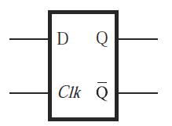
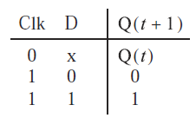
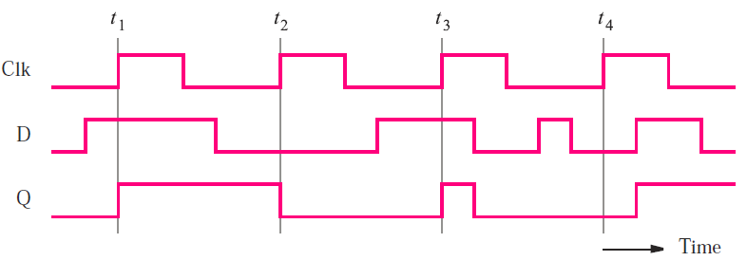
Gated D latch
Circuit symbol and characteristic table
Timing diagram

Slide 9
Level sensitive circuits
Level sensitive circuits
  Circuit output is controlled by clock level
  Circuit output keeps changing according to inputs when clock is active
  Circuit output value may change multiple times when clock is active
Examples
  Gated SR latch
  Gated D latch
  Clock is active high: Clk=1

Slide 10
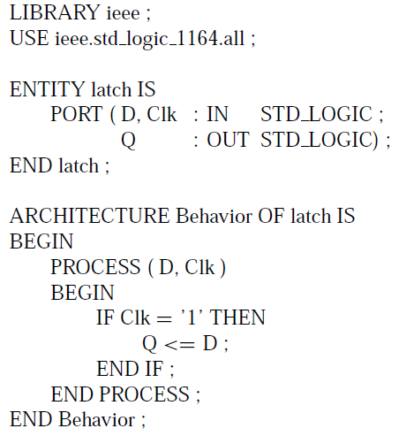
VHDL code for gated D latch

Slide 11
Flip-Flops
Edge triggered circuits
  Output only changes at clock edges (i.e., clock changes from one value to the other)
  Positive edge: clock changes from 0 to 1
  Negative edge: clock changes from 1 to 0
  Output value changes no more than once during one clock cycle
Examples
  D flip-flop
  T flip-flop
  JK flip-flop

